Slide 1
Unix Introduction

Slide 2

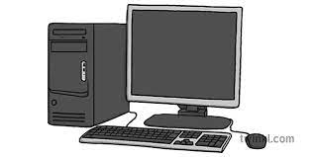
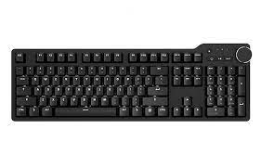

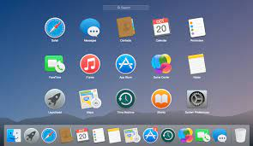


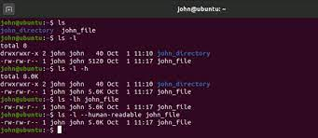
Background : Human interaction with computers
Keyboard
GUI
Touch screens
Mouse
Voice recognition
systems
CLI

Slide 3


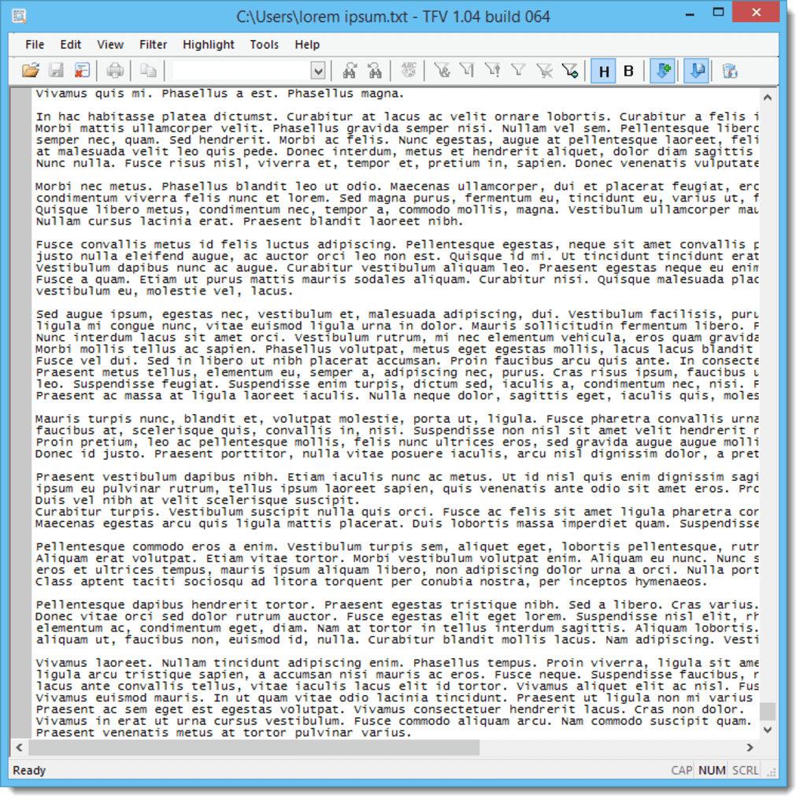




However, the GUI scales poorly with repetitive tasks
50 directories
Example:
Time, Energy
copy
paste
# of
repetitive tasks
CLI

Slide 4


Unix shell
Command line interface (CLI)
Scripting language
Time, Energy
# of
repetitive tasks
Example:
Notes:
The Unix shell is both a command-line interface (CLI) and a scripting language, allowing such repetitive tasks to be done automatically and fast. With the proper commands, the shell can repeat tasks with or without some modification as many times as we want. Using the shell, the task in the literature example can be accomplished in seconds.

Slide 5
Unix shell
Bash is the default shell on most modern implementations of Unix.
Git Bash is a piece of software that enables Windows users to use a Bash like interface when interacting with Git.
The shell is a program where users can type commands. While a GUI presents you with choices to select, CLI choices are not automatically presented to you, so you must learn a few commands like new vocabulary in a language you’re studying.
The grammar of a shell allows you to combine existing tools into powerful pipelines and handle large volumes of data automatically. Sequences of commands can be written into a script, improving the reproducibility of workflows.
The command line is often the easiest way to interact with remote machines, supercomputers, clusters and cloud computing systems, thus being able to interact with the shell is becoming a necessary skill.

Slide 6
Today , we will use the shell for:
Navigate files and directories
Working with files and directories

Slide 7


Slide 8
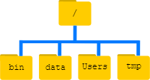
Home directory :/c/Users/maxplanck
Root directory
Notice that there are two meanings for the / character.
When it appears at the front of a file or directory name, it refers to the root directory.
When it appears inside a path, it’s just a separator.
/C/Users/maxplanck/Documents
Notes:
The topmost directory is the root directory that holds everything else. We refer to it using a slash character, /, on its own; this character is the leading slash in /Users/nelle.
Inside that directory are several other directories: bin (which is where some built-in programs are stored), data (for miscellaneous data files), Users (where users’ personal directories are located), tmp (for temporary files that don’t need to be stored long-term), and so on.

Slide 9
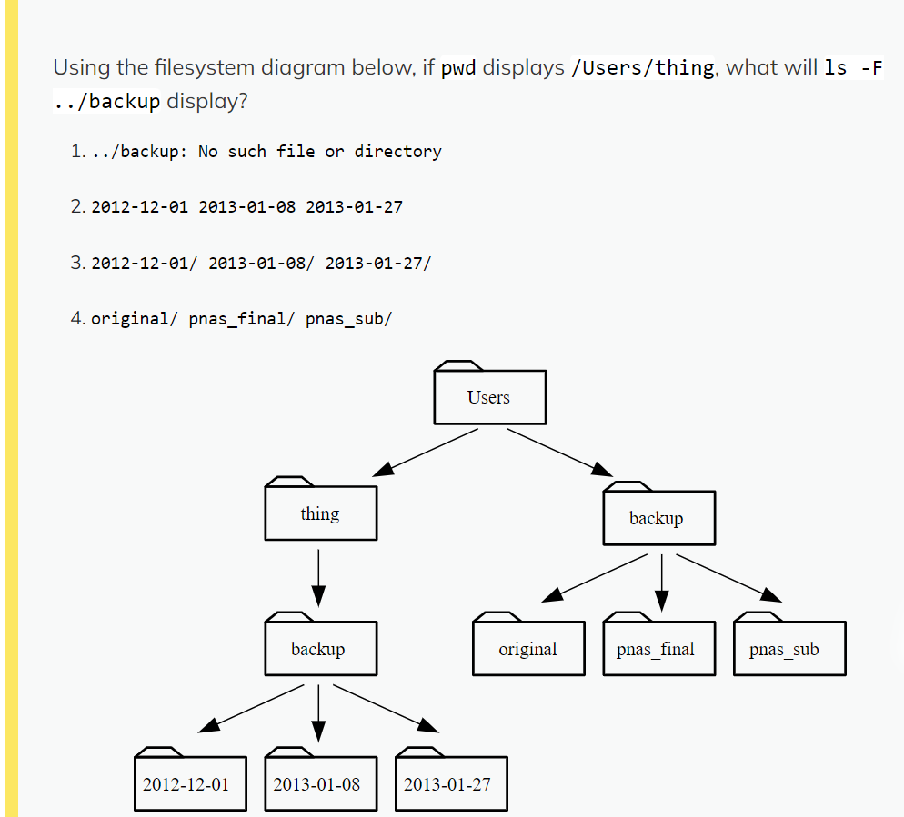

Slide 10
File structure
- Locate your Desktop folder
- Move to your Desktop folder
- Create a directory with the following internal pattern:
Thesis
|── data/
│ |── a.dat
│ |── b.dat
│ |── c.dat
|── docs/
|── scripts/
|── raw_data_processing.py
manuscript.tex

